Slide 1
Homework 3
By Seth LeMar, Anh Nguyen, Stephen Peterson and Bryan Strohmeyer

Slide 2
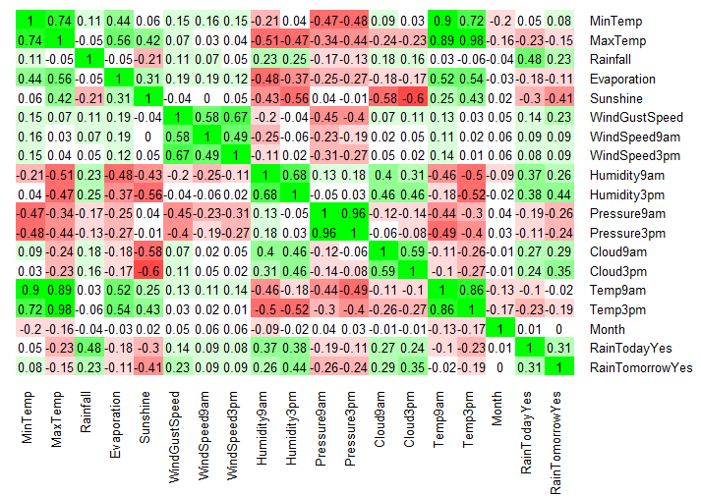
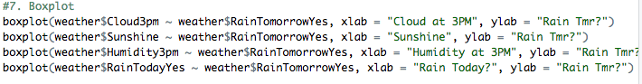
Finding the Most Useful Predictors
The following predictors have the strongest correlation with predicting likelihood of rain the next day (correlation) :
Cloud3pm (.35)
RainTodayYes (.31)
Humidity3pm (.44)
Sunshine (-.41)

Slide 3
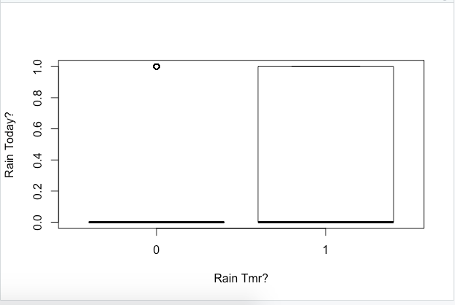
Box Plots for predictors
Since RainTomorrow and RainToday are both binomial categorical variables, it doesn’t work very well to prove if it is a good predictor
Even though it doesn’t show it well, it still shows that when it rains, it isn’t unlikely that it will rain tomorrow
On the other hand, when it rains today, the occurrences when it rains the next day are outliers, therefore showing it isn’t as likely

Slide 4
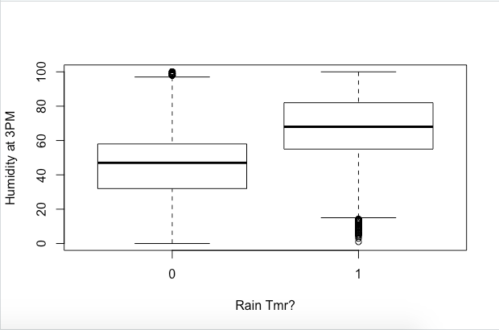
Box Plots for predictors
When there is higher Humidity at 3pm, it is much more likely that it rains tomorrow. Seems like a good predictor so far from this box plot

Slide 5
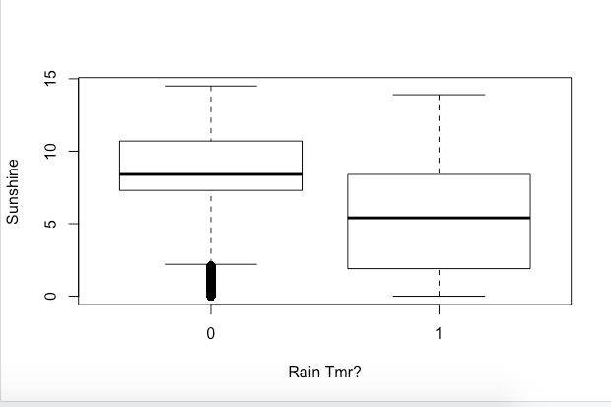
Box Plots for predictors
This box plot has a much higher than others. When sunshine is low, the chances of there being rain tomorrow is more likely

Slide 6
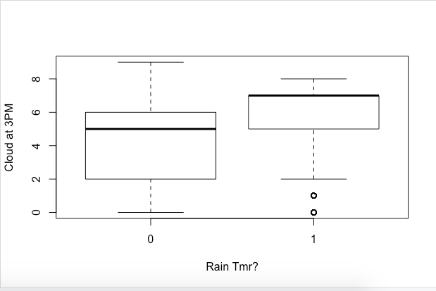
Box Plots for predictors
The more cloudy it is at 3pm, the more likely it is to rain tomorrow

Slide 7
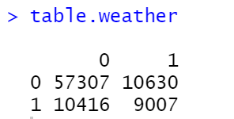
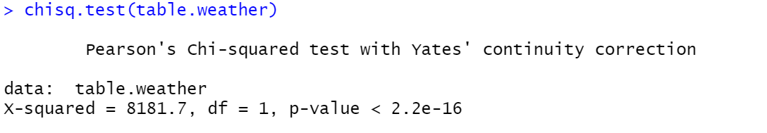
Two-way Contingency Table
Contingency Table:
From the looks of the two-way contingency table, it seems to us that they are not exactly correlated. If it does not rain today, then it is more than likely that it will not rain tomorrow. But if it does rain today, it is close to 50/50 whether it will rain tomorrow. It doesn’t seem like that useful of a predictor.
Chi-square test:
P value is essentially 0 so they are dependent. They are definitely dependent on each other and it is a useful predictor, but we would need to look at other predictors to find the most useful one.

Slide 8
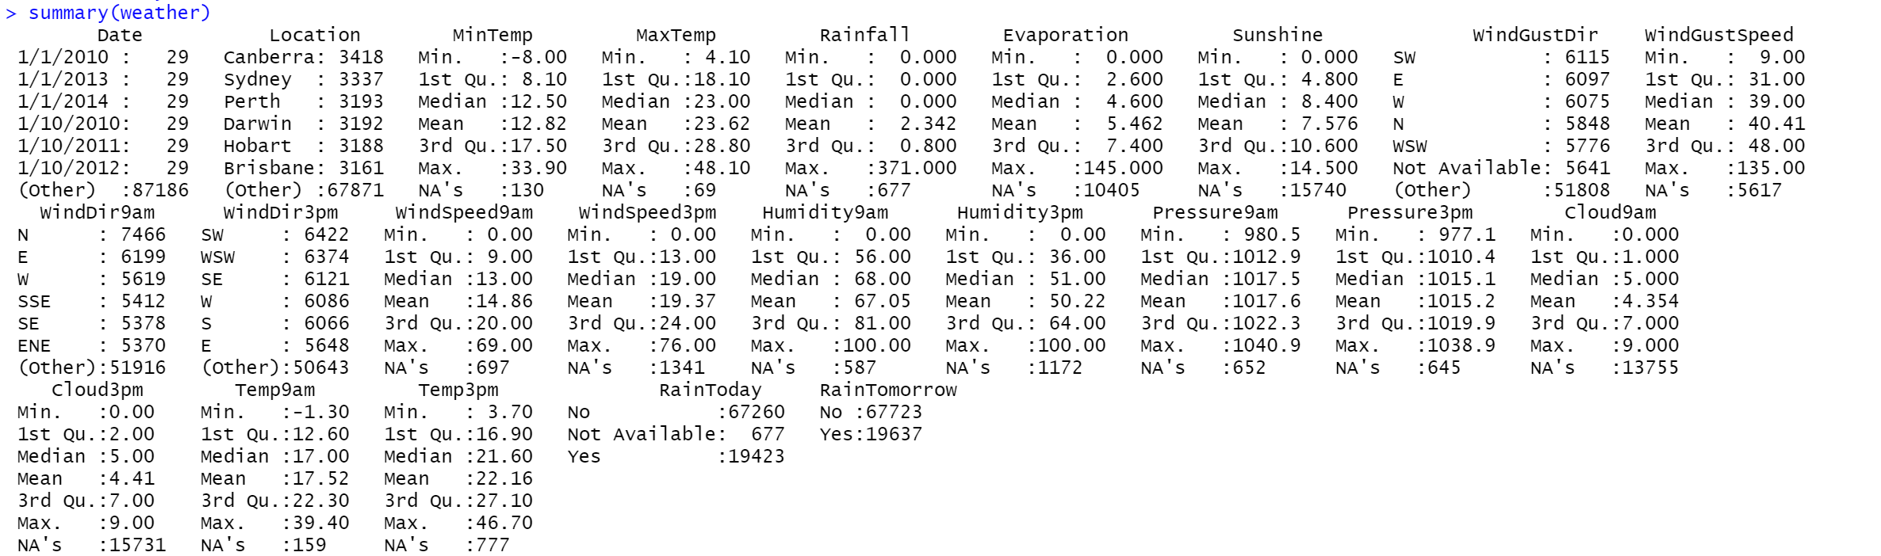
Summary Statistics
A lot of missing data in Evaporation, Sunshine, Cloud9am, Cloud3pm
There is missing data in most of the variables but this one is the worst
Rain Today and Rain Tomorrow only have yes and no answers and can be turned into categorical data very easily
Date won’t be able to be used as numeric data (yet)
All variables with directions won’t be able to be used since there are many different options and no dominant outcome
Same with location

Slide 9
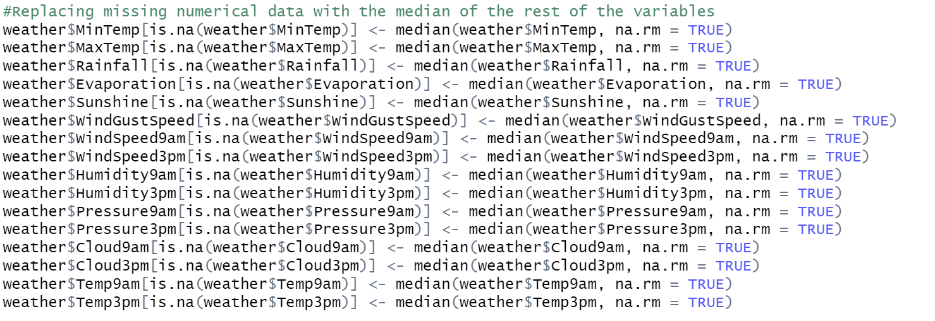
Handling Missing Data
We replace the missing values with the median value of the rest of the variables.

Slide 10
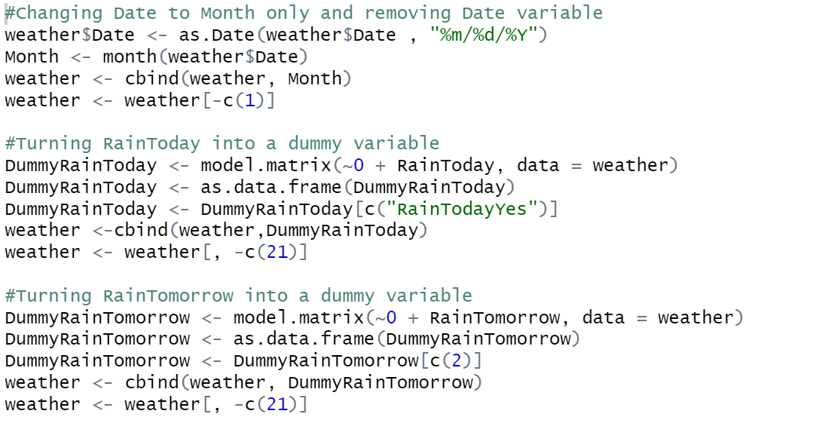
Creating Dummy Variables

Slide 11
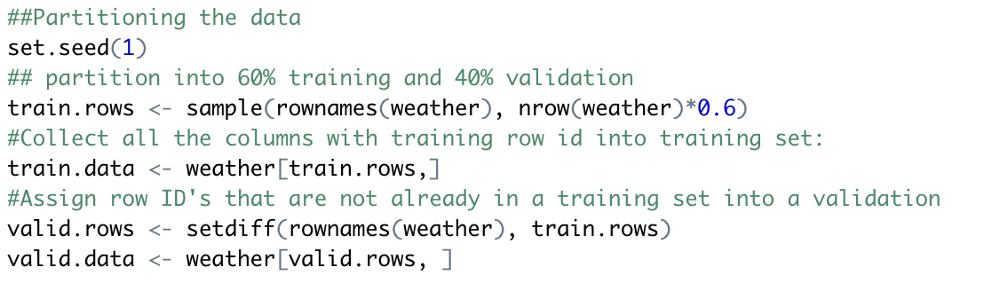
Partitioning the Data

Slide 12
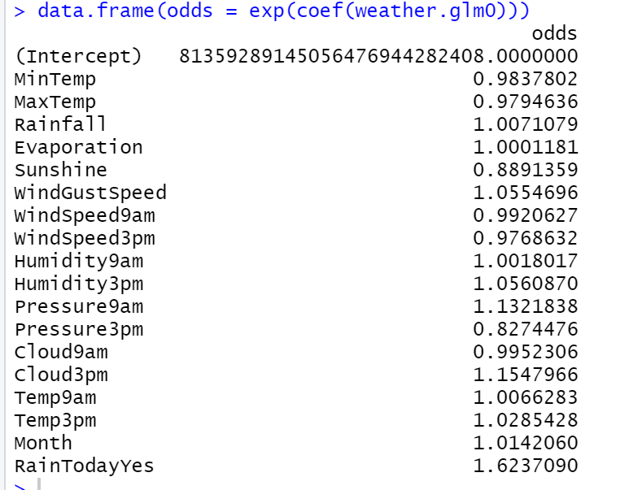
Full Logistic Regression (with .5 cutoff)
Interpretation of the odds
The odds just show how drastic a change to the desired outcome will be with the variable
For example, a 1 unit increase in RainTodayYes will result in a 1.62x increase in the odds of RainTomorrowYes being a 1
RainTodayYes is the highest because it is the only other binary variable and is also correlated as well so this shows how sensitive a correlation between two variables are with each increase or decrease

Slide 13
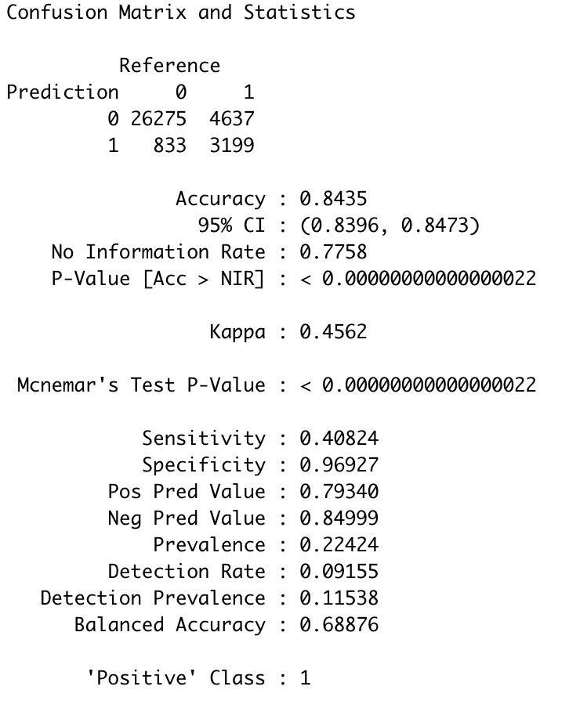
Confusion Matrix
84.35 % accurate if we picked .5 as a cutoff point
The no information rate is the accuracy of the model if the dominant class was picked every time( which would be a 0 for RainTomorrowYes)
This is lower than the accuracy of this model so we can tell that the confusion matrix is relatively accurate

Slide 14
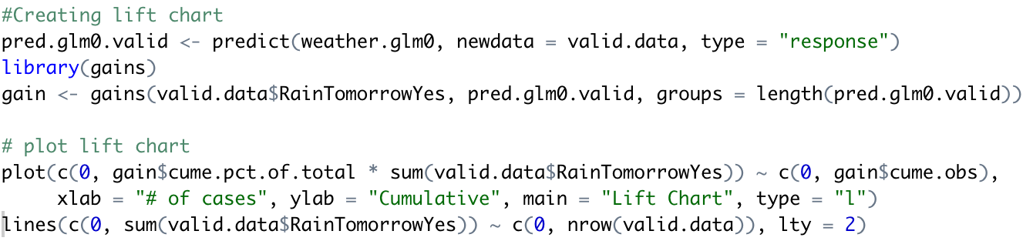
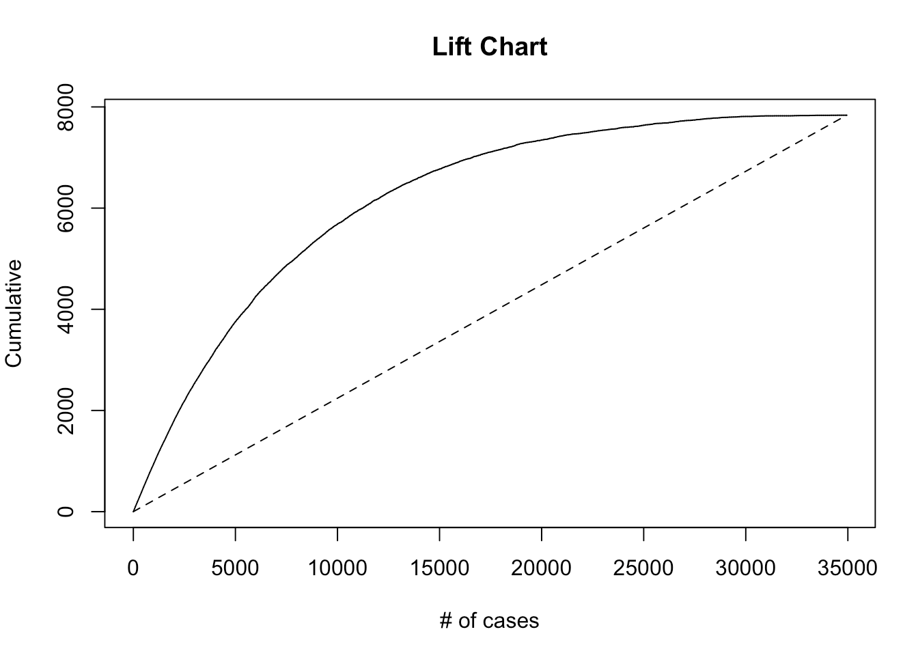
Lift Chart
If we use the top 10,000 cases for our model, the total amount of 1s we would get is around 6,000 but when they’re randomly selected then it is around 2,000
The line for our model plateaus around 15,000-20,000, therefore it’s not worth running this model on a dataset with more than 15000 observations, at the cost of computing power.
Since it is a logarithmic curve, the rate of change keeps decreasing until it is 0

Slide 15
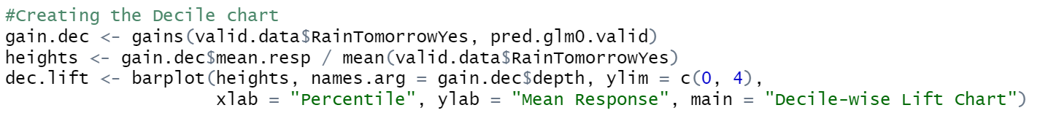
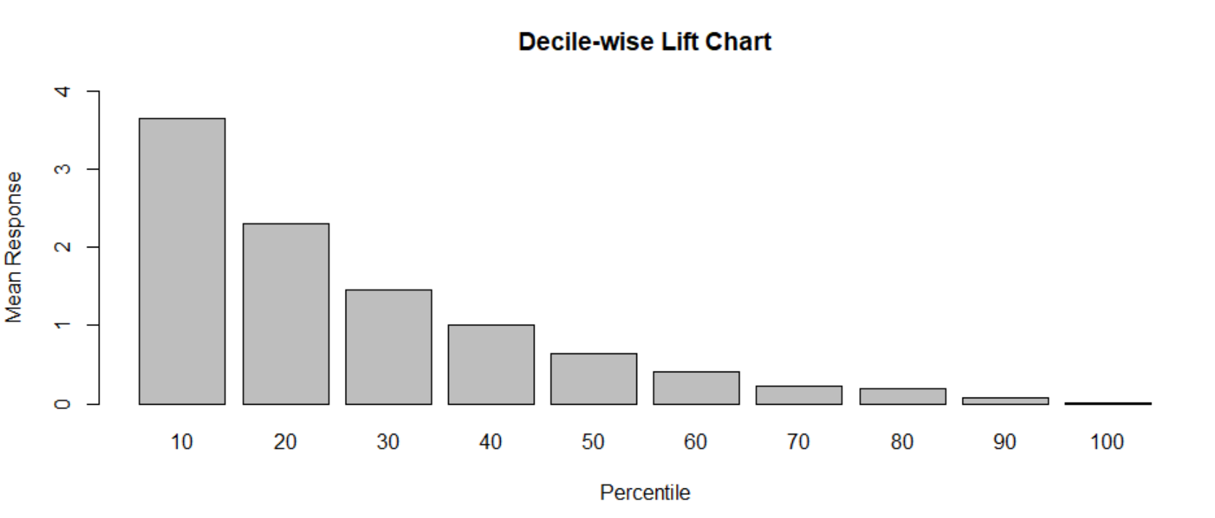
Decile Lift Chart
The top 10 percent of data will predict nearly 4 times as many 1s as randomly selecting 10% of the data
The top 20% will be more than 2x as likely
Our chart goes down exponentially so it makes sense that the higher the percentile we choose, the lower the likelihood of rain relative to a lower percentile

Slide 16
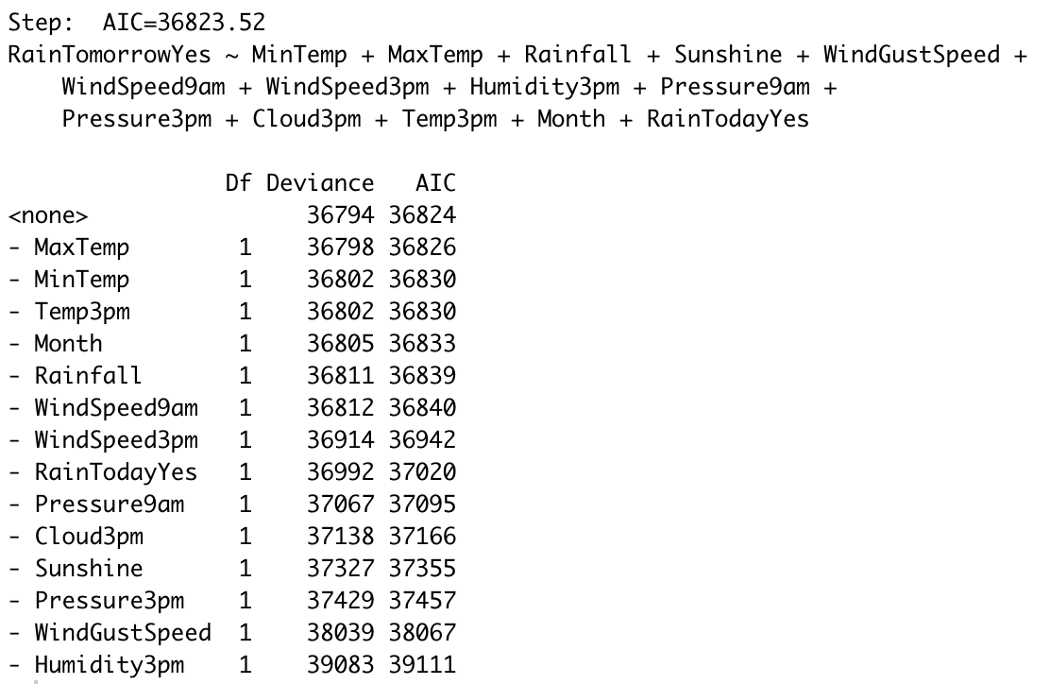
Backward Elimination
AIC: 36,823.52
BIC: 36,956.52
ME: 2.07
RMSE: 2.64
*Same as forward selection and backwards elimination which has the best AIC and BIC but the ME and RMSE are relatively high*

Slide 17
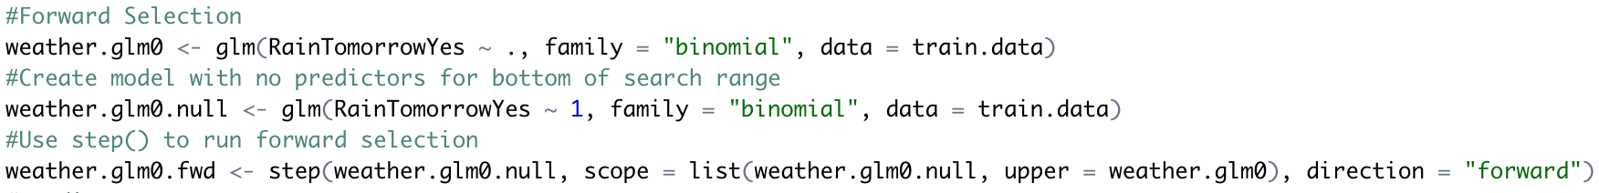
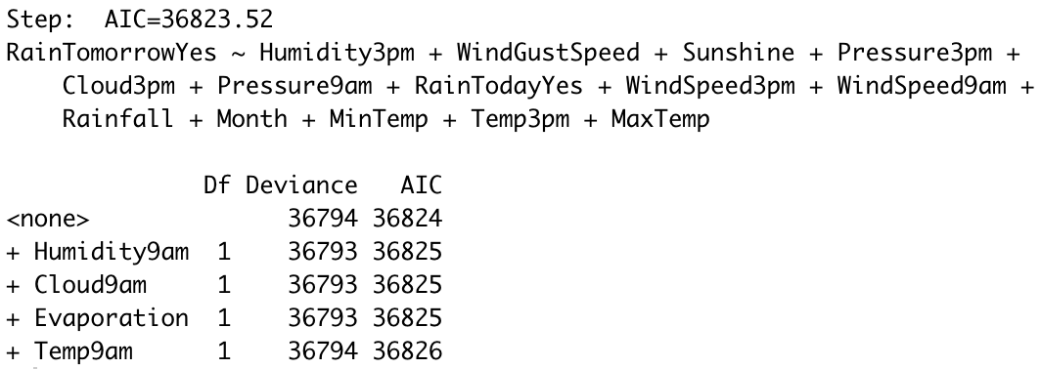
Forward Selection
AIC: 36,823.52
BIC: 36,956.52
ME: 2.07
RMSE: 2.64
*Same as forward selection and backwards elimination which has the best AIC and BIC but the ME and RMSE are relatively high*

Slide 18
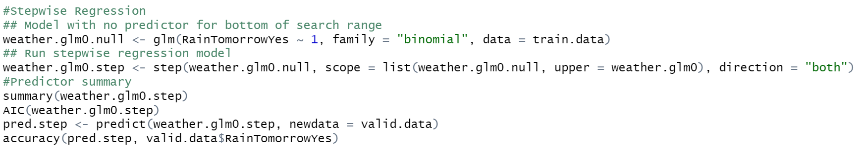
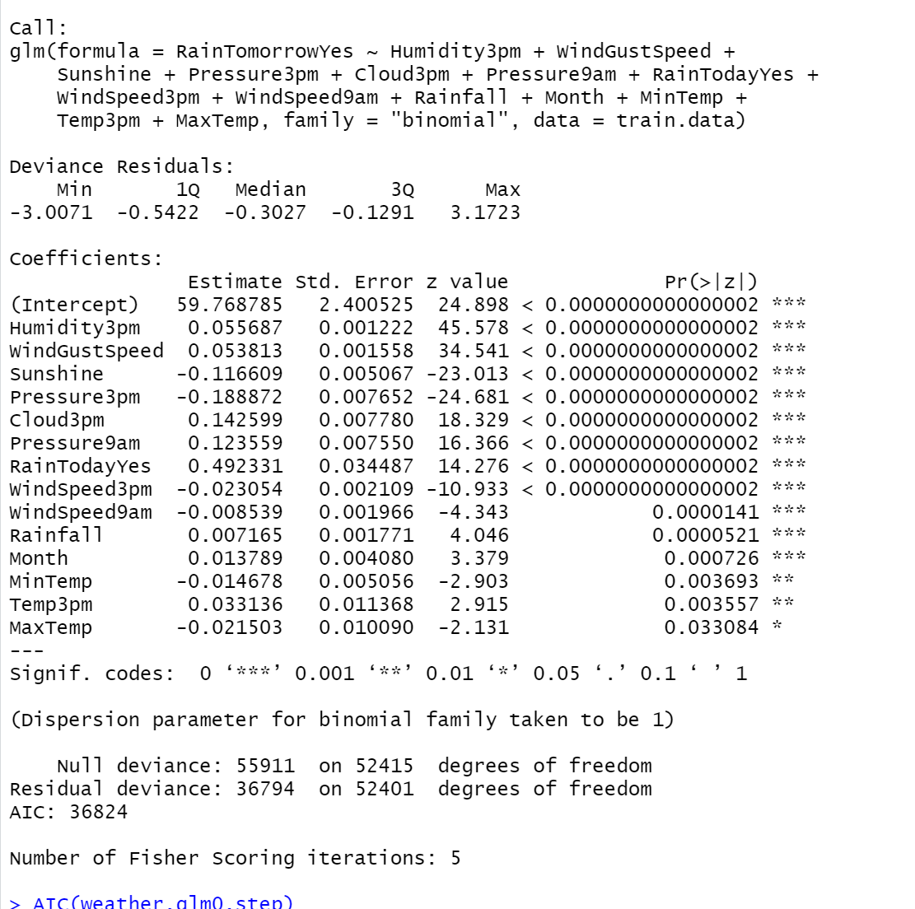
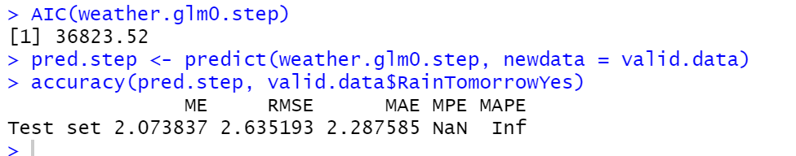
Stepwise Regression
AIC: 36,823.52
BIC: 36956.52
ME: 2.07
RMSE: 2.64
*Same as forward selection and backwards elimination which has the best AIC and BIC but the ME and RMSE are relatively high*

Slide 19
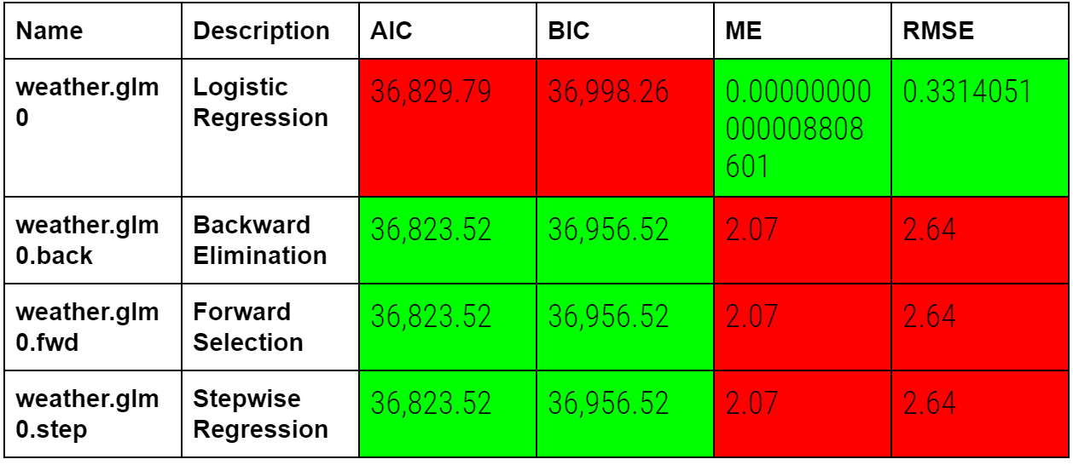
Comparison Table

Slide 20
Summary
Based on the accuracy of each model, it seems that the logistic regression model is the best
The forward selection, backwards elimination and stepwise regression models have the higher likelihood of being true and may be closer to the truth, but the difference between all 3 of those and the original logistic regression model is very small
The RMSE and ME of the logistic regression model are so much lower than the RMSE and ME of the other models
Therefore the error of this model is much smaller and less significant compared to the errors of the other models

